Slide 1
Installation Guide
(Eclipse Plug-in –
Anyframe Tools –
common 1.3.0, codegen 1.3.0.M2, querymanager 1.3.0)
2009. 01. 19
CODELABOR
Shin Sang Jae (codelabor@gmail.com)

Slide 2
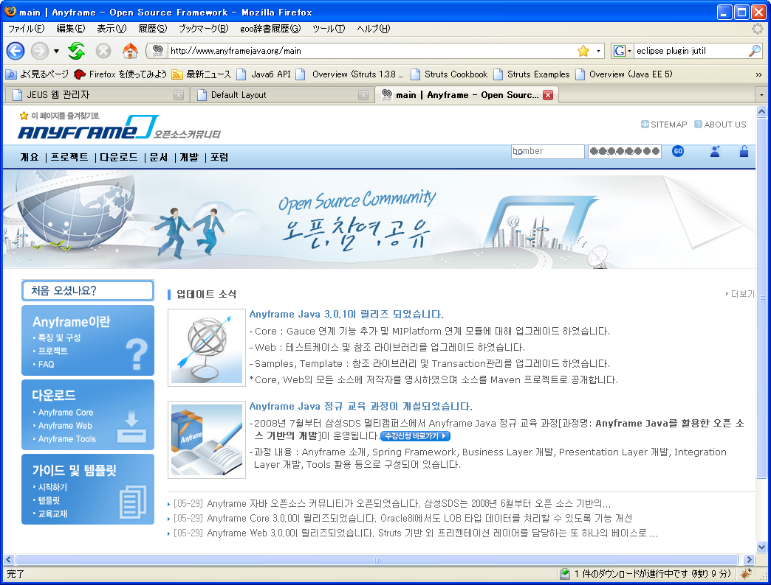
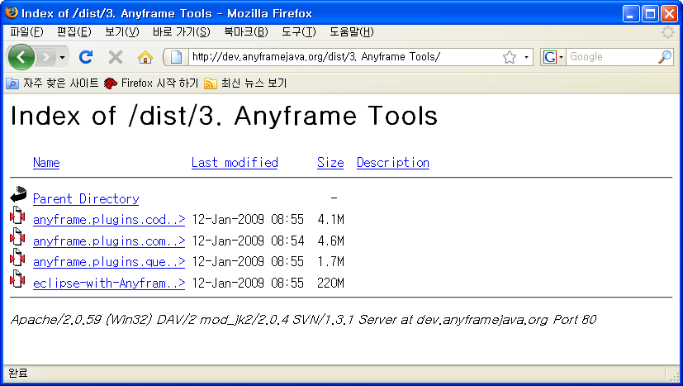
Eclipse Plug-in
Install
Eclipse Anyframe plug-in
Officical Site URL: http://www.anyframejava.org/main
Download Site URL: http://dev.anyframejava.org/dist/3.%20Anyframe%20Tools/
Download Files:
  anyframe.plugins.codegen_1.3.0.zip
  anyframe.plugins.common_2.0.0.zip
  anyframe.plugins.querymanager_1.3.0.zip

Slide 3
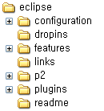

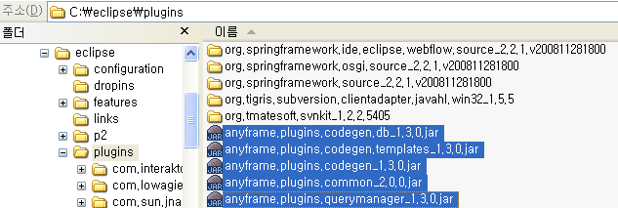
Eclipse Plug-in
Install
Copy to plugins directory

Slide 4
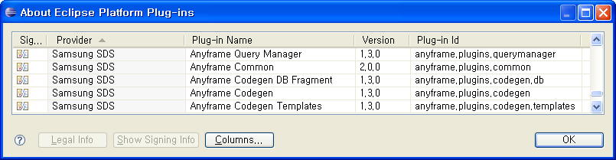
Eclipse Plug-in
Install
Eclipse > Help > About Eclipse Platform > Plug-in Details

